Slide 1
REIMAGINING THE EDUCATION RESEARCH COMMONS: TOWARD EPISTEMIC JUSTICE
Presidential Session
Annual Meeting of the American Educational Research Association
April 22, 2022
Notes:
Hello Everyone. Welcome to our Presidential Session on “Reimagining the Education Research Commons: Toward Epistemic Justice.” I’m Pamela Moss from the University of Michigan School of Education. My Michigan colleague, James Hammond, and I will be chairing the session—which we co-designed with participants listed in your program. [We’ll be audio recording the plenary parts of this session to support next steps in our work.]

Slide 2
inspirations: Annual meeting theme
“Cultivating equitable educational systems” requires us
to look critically at (in)equities in our education research commons--our systems for producing, sharing, and putting research to work and
to imagine possibilities for change.
Notes:
This session was inspired by the Annual Meeting Theme of “cultivating equitable educational systems for the 21st century”. We began with the premise that responding to its challenges requires us to look critically at inequities in our education research commons—our systems for producing, sharing, and putting research to work—and it requires us to imagine possibilities for change.

Slide 3
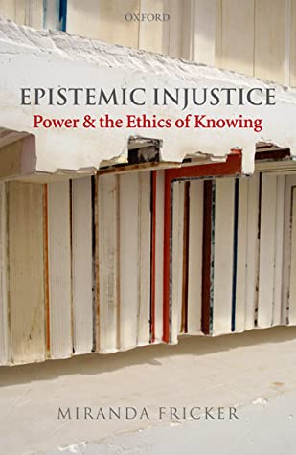
InspirationS: epistemic (In)Justice
To support this work, we take up questions concerning epistemic (in)justice, which speaks to power and the ethics of knowing (Fricker, 2007)
Fricker, M. (2007). Epistemic injustice: Power & the ethics of knowing. Oxford UP.
Notes:
To help orient this work, we’ve turned to the concept of epistemic justice, which Miranda Fricker (2007) glosses as being about power and the ethics of knowing.

Slide 4
AGENDA
Introduction
J. W. Hammond & Pamela Moss, University of Michigan
Six Commons Visions
William Penuel & Robbin Riedy, University of Colorado, Boulder
Krystal Villanosa & Megan Bang, Northwestern University & The Spencer Foundation
Kevin Crouse & Drew Gitomer, Rutgers University
June Ahn, University of California, Irvine
Ezekiel Dixon-Román, University of Pennsylvania
Angela Booker, University of California, San Diego & Shirin Vossoughi, Northwestern University
Small Group Dialogue
Notes:
Our goal for today’s session is to catalyze a dialogue about possibilities for change in our education research commons towards epistemic justice. We purposefully designed the session with briefer presentations so there would time to include your voices in the dialogue. To inspire everyone’s imaginations, presenters will sketch possibilities and principles for evolving the commons. Following the presentations, we’ll open the meeting to small group dialogue, where we’ll invite you to think with us about problems possibilities for change.

Slide 5
ORIENTING definitions
Education Research Commons
Epistemic (In)Justice
J. W. Hammond & Pamela Moss University of Michigan
Notes:
We begin with a brief overview of two concepts named in our title—education research commons and epistemic justice from James Hammond.

Slide 6
ORIENTING definitions
Education Research Commons
Epistemic (In)Justice
J. W. Hammond & Pamela Moss University of Michigan
Notes:
As Pamela mentioned, I’ll be offering some brief notes about the commons and about epistemic justice to set the stage for the presentations to follow – and also to support us in collectively thinking, reimagining, and questioning together. I want to acknowledge at the outset that my remarks only scratch the surface of these concepts, and we’re hoping that our conversation today will provide space for digging deeper. Additionally, even though my remarks will be brief, I’ve attempted -- in the spirit of common work and action -- to make these opening remarks heteroglossic, building in quotes and ideas from other scholars who’ve inspired our thinking. Doing so is a small reminder that each time we write and speak about education research, we’re always already engaged in a kind of collective imagining and action.

Slide 7
“The commons is an active verb, not just an inert noun. … It is a resource, plus a defined community and the protocols, values and norms devised by the community to manage needed resources.”
(Bollier, 2014, 173-6)
Notes:
So: let’s turn to the education research commons. When we talk about “commons”—or in our case, a knowledge commons—we mean something more than just treating education research or "knowledge" as a static resource we share. As David Bollier (2014) puts it, “The commons is an active verb, not just an inert noun. … It is a resource, plus a defined community and the protocols, values and norms devised by the community to manage needed resources” (pp. 173-176). In other words, when we think about the education research commons, it’s not just a commons made up of things, like research. A knowledge commons is also made up of communities and processes.

Slide 8
Education Research Commons also include…
Technologies on which we rely
Social structures and practices through which we work
Policies that finance and govern them
Pedagogies through which we learn to participate
Principles underlying the elements above
Notes:
Expanding this definition, we add that the education research commons includes the technologies on which we rely, the social structures and practices through which we work, the policies that finance and govern them, and the pedagogies through which we learn to participate, as well as the principles underlying all of the above. It’s also helpful to remember that talk of “commons” can refer to a global commons in which we are all implicated as education researchers—but it also can refer to the myriad local and translocal commons in which we participate. This session’s presentations will provide frames for reimagining the commons at multiple scales—showing how different configurations of the commons differently shape how we produce, share, and use knowledge.

Slide 9
“Open science aims to ensure the free availability and usability of scholarly publications, the data that result from scholarly research, and the methodologies, including code or algorithms, that were used to generate those data.”
(NASEM, 2018, 1)
National Academies of Sciences, Engineering, & Medicine. (2018). Open science by design: Realizing a vision for 21st century research. National Academies Press.
Notes:
Of course, we’re far from alone in imagining possible futures for the research commons. The open science movement is perhaps the best-known effort to reshape the scholarly commons, and it’s gained considerable traction in the education research community. As described in a 2018 report by the National Academies of Sciences, Engineering, and Medicine, “Open science aims to ensure the free availability and usability of scholarly publications, the data that result from scholarly research, and the methodologies, including code or algorithms, that were used to generate those data” (p. 10).

Slide 10
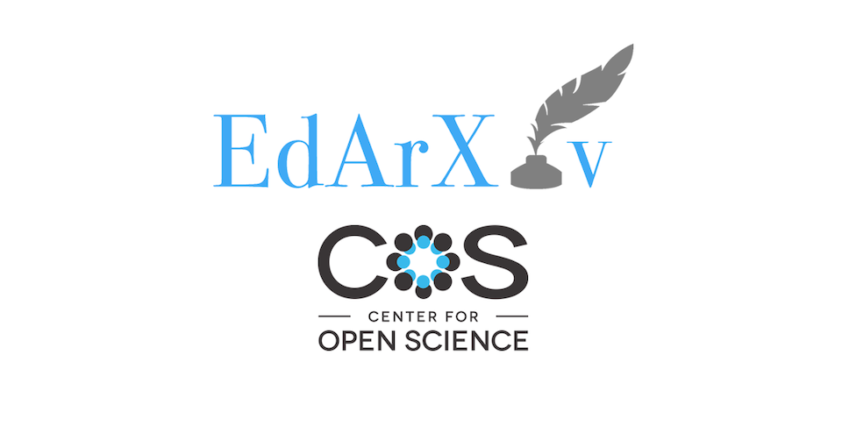
Notes:
In education research, we see the open science movement’s influence in AERA Open -- and in preprint publishing platforms like EdArXiv (which is powered by the Open Science Framework). More generally, this influence can be felt in policies encouraging preregistration or requiring data sharing – to cite just a few prominent examples. In a world where education research is often privatized, paywalled, and inaccessible, there’s much to learn from initiatives to make our knowledge commons more open, available, and accountable.

Slide 11
Epistemic Goals in Annual Meeting Theme
Call for “systems that honor the full range of knowing” (i.e., across “human experiences, identities, and practices”)
Answering this call requires reimagining the commons
We need a commons that encourages learning across different knowledges and ways of knowing
Notes:
And yet -- by our reading, the goals, tools, and practices foregrounded in open science resources often do not provide explicit guidance for enacting many of the epistemic goals articulated in this year’s Annual Meeting Theme. In this year’s theme, we see a call for “systems that honor the full range of ways of knowing”—that is, across “human experiences, identities, and practices.” We also find an emphasis on facilitating new ways of relating and collaborating “across multiple disciplines and boundaries” (Nasir et al., 2021). These goals require a commons that provokes and inspires us to engage with and learn from conceptions of knowledge and ways of knowing that may differ from our own. Arguably, what we need is a commons configured to advance epistemic justice.

Slide 12
Who has voice and who doesn’t? Are voices interacting with equal agency and power? In whose terms are they communicating? Who is being understood and who isn’t (and at what cost)? Who is being believed? And who is even being acknowledged and engaged with?
(Kidd, Medina, & Pohlhaus, 2017, 1)
Pohlhaus Jr., G. (2017). Varieties of epistemic injustice. In I. Kidd, J. Medina, G. Pohlhaus Jr. (Eds.), The Routledge handbook of epistemic injustice (pp. 13-26). Routledge.
Notes:
In this vein, our thinking about epistemic justice is informed by philosophers Ian James Kidd, José Medina, and Gaile Pohlhaus Jr. (2017), who tell us that investigating epistemic (in)justice involves taking up questions like the following: “Who has voice and who doesn’t? Are voices interacting with equal agency and power? In whose terms are they communicating? Who is being understood and who isn’t (and at what cost)? Who is being believed? And who is even being acknowledged and engaged with?” (Kidd et al., 2017, p. 1). Each of these questions has relevance for the education research commons. These are questions we can bring, for instance, to our journals, our departments, and our professional organizations.

Slide 13
Who has voice and who doesn’t? Are voices interacting with equal agency and power? In whose terms are they communicating? Who is being understood and who isn’t (and at what cost)? Who is being believed? And who is even being acknowledged and engaged with?
(Kidd, Medina, & Pohlhaus, 2017, 1)
Pohlhaus Jr., G. (2017). Varieties of epistemic injustice. In I. Kidd, J. Medina, G. Pohlhaus Jr. (Eds.), The Routledge handbook of epistemic injustice (pp. 13-26). Routledge.
Notes:
Taken together, questions like these invite us to investigate the possibility of structural inequities in knowledge systems, highlighting exclusions that we need to illuminate and challenge. Epistemic injustices in the education research commons not only do harm to those excluded – they can also constrain collective imagination, insights, and understandings in education research as a field, narrowing and diminishing what we share and what we work toward in common. As Pohlhaus Jr. argues, “epistemic communities from which certain knowers are unfairly excluded lack the beneficial epistemic friction” that might enable the system to notice and address its limitations (p. 18). Thus, scholars of epistemic justice caution us to beware of centralized knowledge systems that advocate universal standards.

Slide 14
“[We need to interrogate] who has the ability to set agendas, standards, and norms; to make decisions and [define] the conditions of participation; and ultimately, to control how knowledge infrastructures are built.” “[We need dialogue that] nurtures curiosity, appreciation, and respect for diverse ways of knowing the world… [along with] time and space…to develop collaborative imaginaries for more just and equitable knowledge infrastructures.”
(Albornoz, Okune, & Chan, 2020, 71-4)
Albornoz, D., Okune, A., & Chan, L. (2020). Can open scholarly practices redress epistemic injustice? In M. P. Eve & J. Gray (Eds.), Reassembling scholarly communications: Histories, infrastructures, and global politics of open access (pp. 65-79). MIT Press.
Notes:
In the words of Denisse Albornoz, Angela Okune, and Leslie Chan (2020), we need to interrogate “who has the ability to set agendas, standards, and norms; to make decisions and [define] the conditions of participation; and ultimately, to control how knowledge infrastructures are built” (p. 72). To these ends, they encourage dialogue that “nurtures curiosity, appreciation, and respect for diverse ways of knowing the world” (p. 71), along with “time and space…to develop collaborative imaginaries for more just and equitable knowledge infrastructures” (p. 74). That’s the kind of conversation we hope to catalyze today.

Slide 15
“[We need to interrogate] who has the ability to set agendas, standards, and norms; to make decisions and [define] the conditions of participation; and ultimately, to control how knowledge infrastructures are built.” “[We need dialogue that] nurtures curiosity, appreciation, and respect for diverse ways of knowing the world… [along with] time and space…to develop collaborative imaginaries for more just and equitable knowledge infrastructures.”
(Albornoz, Okune, & Chan, 2020, 71-4)
Albornoz, D., Okune, A., & Chan, L. (2020). Can open scholarly practices redress epistemic injustice? In M. P. Eve & J. Gray (Eds.), Reassembling scholarly communications: Histories, infrastructures, and global politics of open access (pp. 65-79). MIT Press.
Notes:
To think explicitly about the future of the education research commons, then, is to question what we share—or seek to share—in common. But it’s also more than that: It’s to interrogate who counts as the communal “we.” It’s to reconsider how we manage, facilitate, or constrain access to research and related resources. It’s to investigate how we stage opportunities for collaboration and learning across differences. And it’s also, crucially, a demand to take stock of the social stakes and significance of these design options for epistemic justice. It’s an invitation to imagine and plan for a new and different future for education research. Today, we’re excited to join you in this work.

Slide 16
“Although many educators and policy makers insist that we have to ‘get back to normal,’ I want to suggest that ‘going back’ is the wrong thing for children and youth who were unsuccessful and oppressed in our schools before the pandemic. Normal is where the problems reside.”
(Ladson-Billings, 2021, p. 68)
Ladson-Billings, G. (2021). I’m here for the hard re-set: Post pandemic pedagogy to preserve our culture. Equity & Excellence in Education, 54, 68-78.
Notes:
I want to conclude this opening overview by raising one more question. Writing about responses to education in the wake of COVID-19, Gloria Ladson-Billings (2021) observes that “Although many educators and policy makers insist that we have to ‘get back to normal,’ I want to suggest that ‘going back’ is the wrong thing for children and youth who were unsuccessful and oppressed in our schools before the pandemic. Normal is where the problems reside” (Ladson-Billings, 2021, p. 68). Extending this idea, the present moment is one where we must ask ourselves about what is potentially problematic about “going back to normal” in education research. What kind of redesign or “re-set” is needed? What future for the education commons do we want to collectively work toward?

Slide 17
six commons visions… … to spark our imaginations
William Penuel & Robbin Riedy, University of Colorado, Boulder
Krystal Villanosa & Megan Bang, Northwestern University & The Spencer Foundation
Kevin Crouse & Drew Gitomer, Rutgers University
June Ahn, University of California, Irvine
Ezekiel Dixon-Román, University of Pennsylvania
Angela Booker, University of California, San Diego & Shirin Vossoughi, Northwestern University
Notes:
In a moment, our presenters will each share a vision for the commons, speaking in the order on your slide. As Pamela mentioned, we’ve designed our session so that presentations will be brief, offering provocations or questions that spark our imaginations and help us reimagine together. Your ideas and imaginings are at the heart of what we’re hoping to accomplish in this session. So: To support the small group dialogue to follow, we’d like to suggest some things you might listen for in each presentation as you consider your own responses and imaginings.

Slide 18
In today’s presentations, you might listen for the following:
What concern about the existing commons is being addressed?
What values or principles are advanced?
What’s being imagined as a change toward more equitable education systems—and how?
What do YOU see as the contrasts and complementarities in the different presentations today?
Notes:
What concern about the existing commons is being addressed?
What values or principles are being advanced?
What’s being imagined as a change toward more equitable education systems—and how? AND
What do YOU see as the contrasts and complementarities in the different presentations today?
After these presentation, we’ll offer a few guidelines for small group dialogue.

Slide 19
Works Cited
Albornoz, D., Okune, A., & Chan, L. (2020). Can open scholarly practices redress epistemic injustice? In M. P. Eve & J. Gray (Eds.), Reassembling scholarly communications: Histories, infrastructures, and global politics of open access (pp. 65-79). MIT Press.
Fricker, M. (2007). Epistemic injustice: Power & the ethics of knowing. Oxford UP.
Kidd, I., Medina, J., & Pohlhaus Jr., G. (2017). Introduction to The Routledge handbook of epistemic injustice. In I. Kidd, J. Medina, G. Pohlhaus Jr. (Eds.), The Routledge handbook of epistemic injustice (pp. 1-9). Routledge.
National Academies of Sciences, Engineering, & Medicine. (2018). Open science by design: Realizing a vision for 21st century research. National Academies Press.
Pohlhaus Jr., G. (2017). Varieties of epistemic injustice. In I. Kidd, J. Medina, G. Pohlhaus Jr. (Eds.), The Routledge handbook of epistemic injustice (pp. 13-26). Routledge.

